Slide 1














Coffee Data Analysis
TransformingDataintoExperiences
By Makhloufi Mahdi
Imagine a Monday morning at Hell's Kitchen café, where by 9:15 AM revenue hits€1,500 per hour

Slide 2




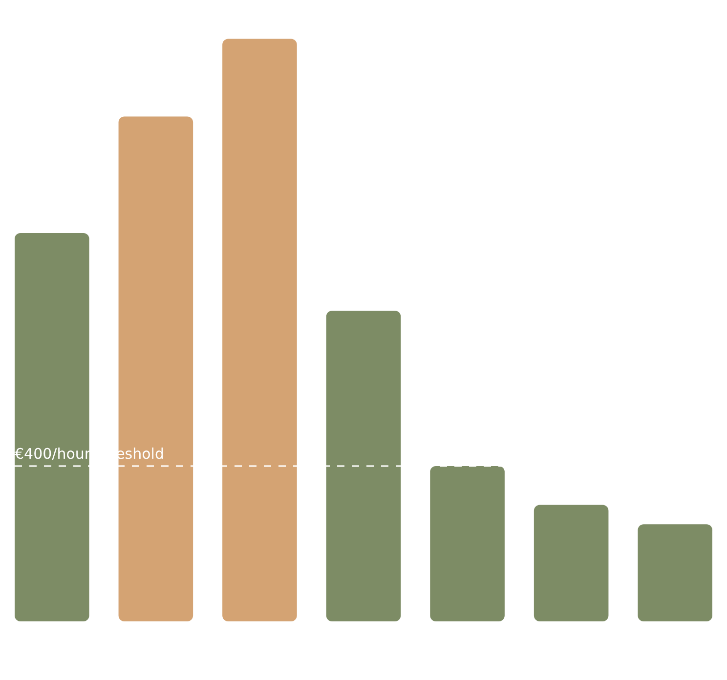


The Problem –Missed Opportunities
The Challenge
Revenue Contrast: Morning vs. Afternoon
While the morning rush at Hell's Kitchen café generates impressive revenue, the hours following 11:30 AM present a considerable challenge with sales declining dramatically.
This stark contrast highlights a critical question:How can we effectively maximize sales and enhance the customer experience throughout the entire day?
Data Evidence
Morning peak revenue:€1,500/hourat 11:18 AM
Afternoon revenue consistently fallsbelow €400/hour
Underutilized products during off-peak times suggest missed cross-selling opportunities
Transforming these slower periods into valuable opportunities is key to business growth

Slide 3













Data & Methodology –Our Analytical Approach
To transform coffee sales data into actionable insights, we implemented a comprehensive analytical workflow using specialized tools
Alteryx
SQL
PySpark
Looker Studio
Alteryx
SQL
PySpark
Looker Studio
Cleaned raw sales data
Calculated weekly revenue trends
Identified correlations between data points
Created interactive dashboards
Converted storeID and productID into usable formats
Identified top-performing products
Performed regression analysis
Incorporated filters for product type, category
Removed irrelevant columns
Streamlined dataset for analysis
Conducted Pareto analysis
Conducted time series analysis
Added store location and date range filters
Pinpointed key products and categories
Enabled scalable computation for large datasets
Enabled exploration of tailored insights

Slide 4












Key Insights –Revenue Peaks and Valleys
Peak Revenue
Low Revenue
Golden Hours
January 7-9 consistently generated:
January 13 & 25 saw:
Most profitable time:
€1,500/hour
€250-400/hour
9:00-11:30 AM
3-day peak period
Significant sales drop
Morning rush
January Revenue Performance
Peak Days
Low Days
Golden Hours
Key Insight:The café experiences consistent patterns in daily revenue, with significant opportunities during the morning rush that decline dramatically in the afternoon.
Understanding these patterns is the first step toward optimizing revenue throughout the day

Slide 5





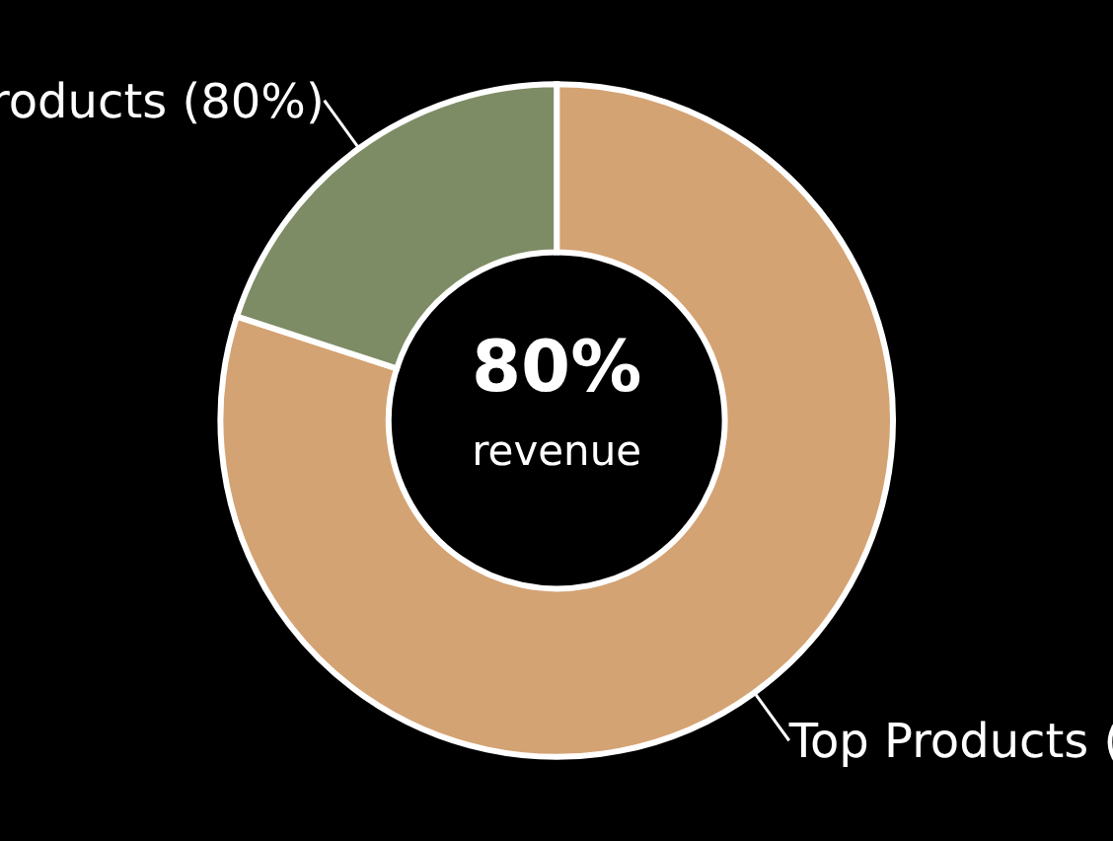












Star Products –Customer Favorites
Top 5 Selling Products
The Pareto Principle
Latte Rg
Latte
Cappuccino
Brazilian Coffee
20%of products generate80%of revenue
Sustainable Coffee
Top products (20%)
Remaining products (80%)

Slide 6




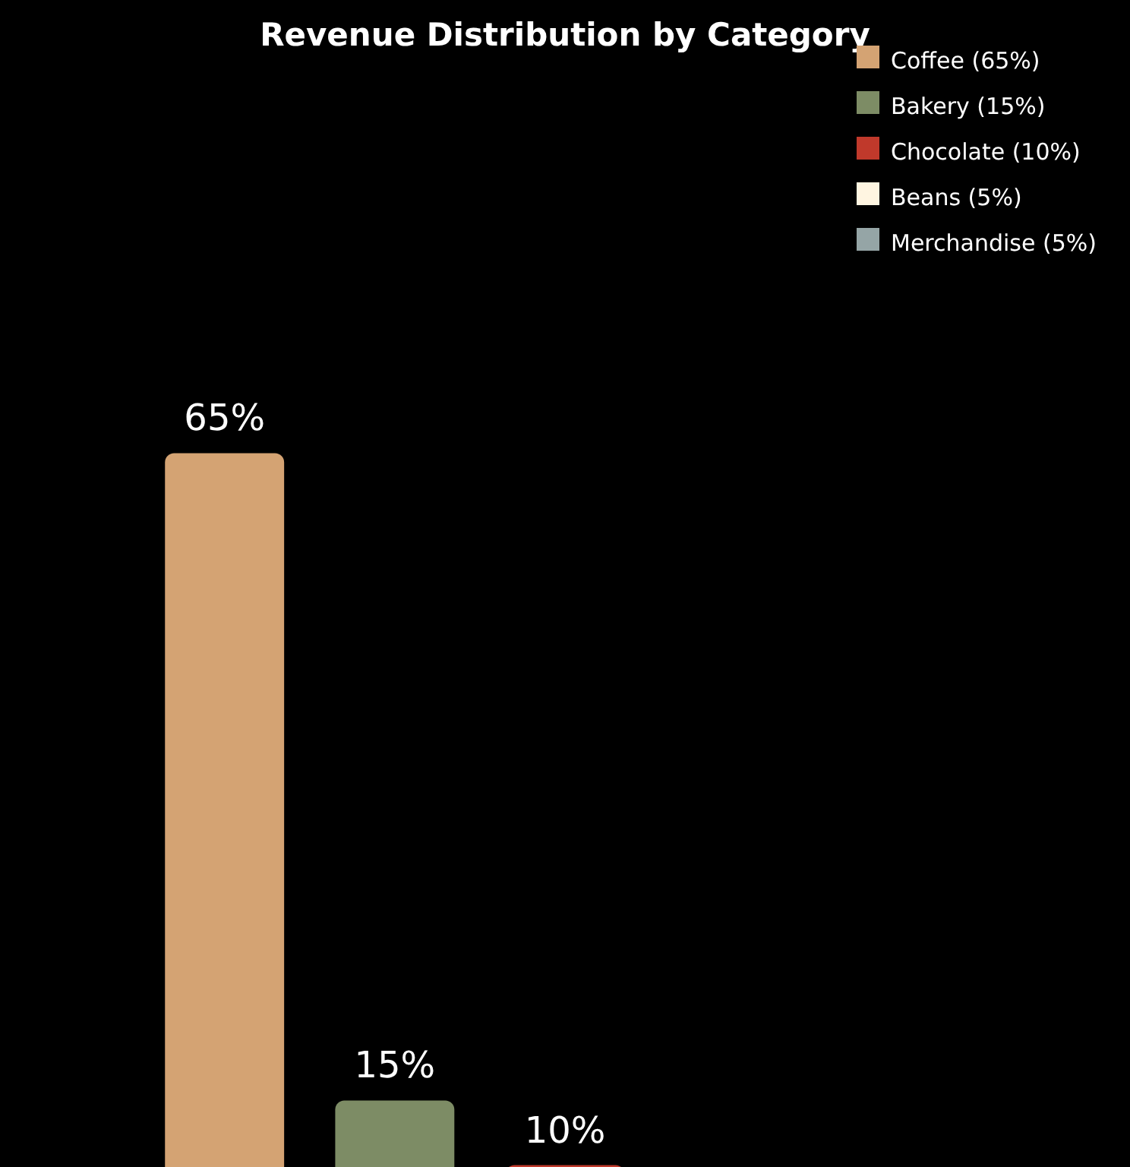


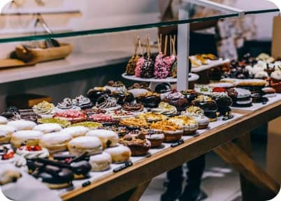


Categories & Opportunities –Beyond Coffee
Revenue by Category
Coffee: Core Revenue Driver
This category remains the primary revenue driver, forming the foundation of the café's sales. Its consistent performance underscores its importance as the core offering.
Bakery & Chocolate: Cross-Selling Opportunities
These categories are identified as prime opportunities for cross-selling. Pairing coffee with pastries or chocolate items can increase the average transaction value.
Beans: Niche Potential
Coffee beans represent a niche product, primarily appealing to loyal customers and coffee enthusiasts who prefer to brew at home. Promoting these high-margin items can cater to a dedicated segment.
Strategic Insight:
Coffee dominates revenue, but other categories present opportunities for growth
Implementing targeted cross-selling strategies between these categories can significantly boost average transaction value and enhance customer experience.
A stacked bar chart would effectively visualize revenue broken down by category

Slide 7

























Customer Personas –The People Behind the Data
Morning Commuter
Afternoon Student
Family Weekend
Speed and efficiency are essential for my morning routine
I need a relaxed environment for study and leisure
We're looking for quality time and shared experiences
Seeks quick, high-quality coffee for workday energy
Focused on relaxation and conducive study environment
Prioritizes quality time and shared experiences
Defaults to Latte or Cappuccino
Often opts for Tea or Bakery items
Likely to purchase Coffee + Bakery combos
Prioritizes efficiency in ordering and service
Values comfortable space to unwind or be productive
Seeks offerings that cater to multiple family members
Key Preference:
Key Preference:
Key Preference:
Quick, strong coffee to fuel the workday
Relaxed atmosphere with study-friendly drinks
Family-friendly coffee and pastry combinations
Strategic Alignment
All recommendations and operational adjustments should be aligned with these personas' specific behaviors and needs to maximize customer satisfaction and increase revenue across different times of the day and week.
Understanding these diverse needs allows the café to tailor its offerings and services

Slide 8















Store Location Insights –Performance Comparison
Store Location Performance
Key Insights
Analysis of the sales data reveals abalanced revenue distributionacross all café locations, indicating a generally effective operational strategy.
Hell's Kitchenconsistently demonstrates aslight leadin overall revenue generation.
Downtown
West End
Hell's Kitchen
Eastside
Primary Location
Strategic Opportunities
Identify and replicate specific best practices from Hell's Kitchen to other locations
South Bay
Standardize successful operational strategies across the entire café network
Leverage Hell's Kitchen's superior performance to enhance overall profitability
Improve customer satisfaction through consistent quality across locations
Hell's Kitchen (Leading)
Other Locations (Balanced)
Uniform strategy works, but best practices can be replicated

Slide 9




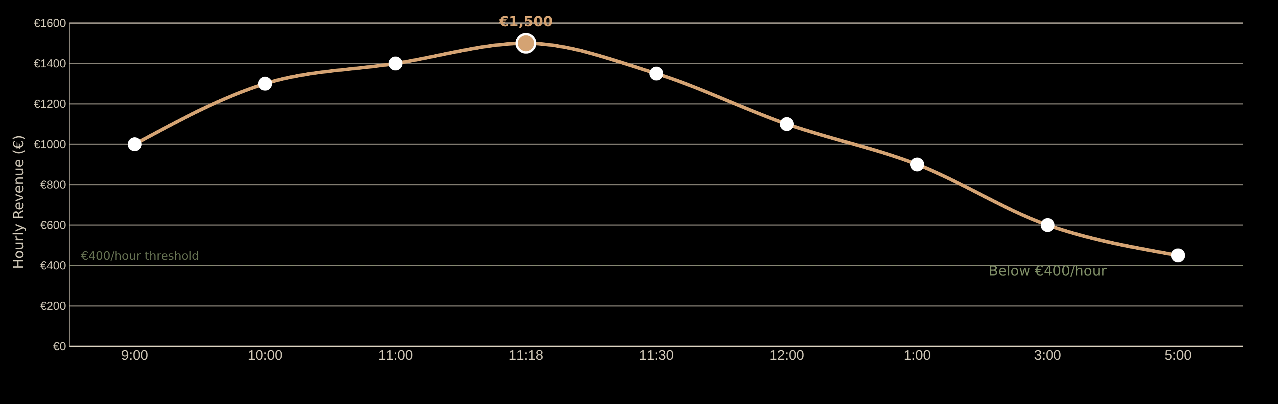



Time-of-Day Insights –The Daily Revenue Curve
Daily Revenue Performance
Peak Performance
Low Performance
Morning Golden Hours
Afternoon Slump
Key Insight
Hours:9:00-11:30 AM
Hours:12:00 PM-5:00 PM
The café generates 3-4x more revenue during peak morning hours compared to afternoon periods, representing a significant opportunity for strategic optimization.
Revenue:€1,500/hourat 11:18 AM
Revenue:Consistently below €400/hour
Understanding time patterns is key to optimizing operational strategies

Slide 10










Monthly Sales Trends –Seasonal Patterns
Monthly Sales Growth
Key Insights
Strategic Implications
Steady growth from February to June, withJunebeing the highest performing month
Increased inventory and staffing required fromspring into early summerto meet growing demand
JanuaryandFebruaryrepresent the low season with consistently lower sales
January and February present opportunities fortargeted promotionsto stimulate sales during quiet periods
Clear seasonal pattern emerges, with a12-month cycleshowing similar performance year-over-year
Adjust staffing levels seasonally to align withnatural sales fluctuationsthroughout the year
Understanding seasonal patterns enables strategic business planning

Slide 11
















Recommendations –Turning Insights Into Revenue
Optimize Off-Peak Hours
Coffee + Biscotti Combos
Implement strategies to boost sales during slower periods, such as introducing small plates, late morning promotions, or happy hours.
Introduce attractive combo deals, such as a coffee and biscotti pairing. This cross-selling technique can significantly increase the average transaction value.
Potential Impact:
+15% revenue increase
Potential Impact:
+€2,000/month
Premium Teas & Merchandise
Replicate Hell's Kitchen
Use Forecasts for Planning
Capitalize on niche markets by actively promoting premium teas and branded merchandise. This caters to diverse customer preferences and offers additional revenue streams.
Analyze the operational and marketing strategies employed by the Hell's Kitchen location, which slightly leads in revenue, and replicate these successful practices across other stores.
Leverage sales data and time-series analysis to improve inventory management and staffing schedules. Accurate forecasting ensures adequate stock during peak times and prevents overstaffing during lulls.
Potential Impact:
Standardized high performance
Potential Impact:
Operational efficiency
Potential Impact:
Niche growth
Potential Revenue Impact
These strategies can transform missed opportunities into significant revenue streams

Slide 12


















Conclusion –Creating Experiences, Not Just Serving Coffee
The café's success extends beyond beverages—it's about crafting distinct experiences for its diverse clientele.
Fast Mornings
Relaxing Afternoons
Family Weekends
9:00-11:30 AM
1:00-5:00 PM
9:00-11:00 AM
Primary revenue driver
Cross-selling opportunities
Quality time focus
Morning Commuter persona
Afternoon Student persona
Family Weekend persona
Data-Driven Strategy
Revenue patterns show peaks at 9:00-11:30 AM and valleys after 11:30 AM
Targeted marketing: optimize off-peak hours, introduce combos, replicate best practices
Customer personas reveal distinct needs: speed, relaxation, and quality time
Operational adjustments: inventory management, staffing based on time-of-day
This data-driven approach transformsevery visitinto a memorable experience.
Data isn't just about numbers—it's about creating meaningful experiences

Slide 13












Thank You &Questions
Thank you for your attention!
LinkedIn
GitHub
Email
Data-driven insights can transform any café into a morning gold mine and afternoon gem

